Slide 1
COVID 19 DATA EXPLORATION USING SQL

Slide 2
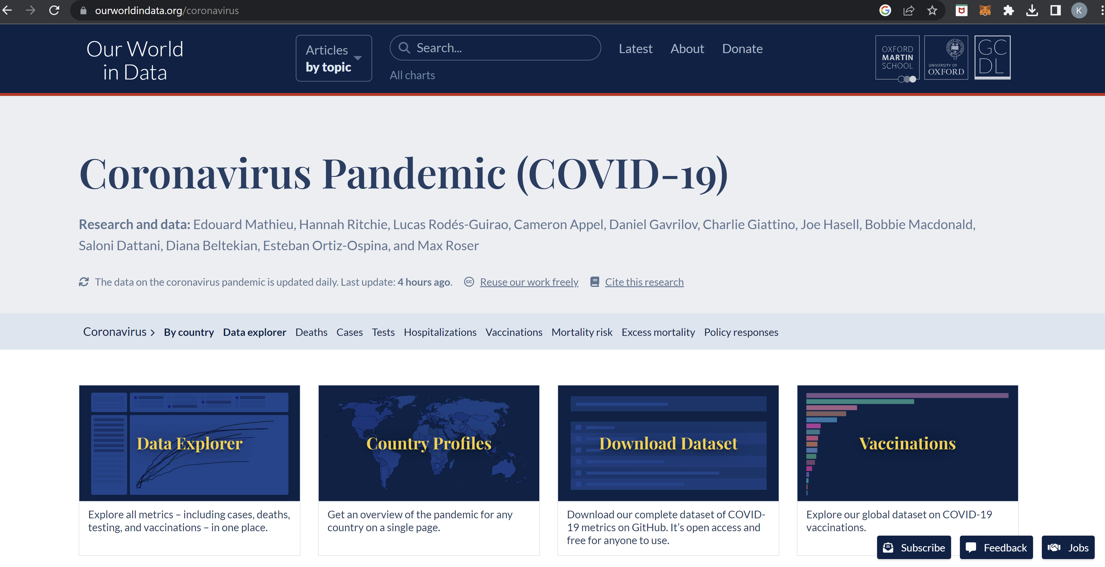
https://ourworldindata.org/coronavirus

Slide 3
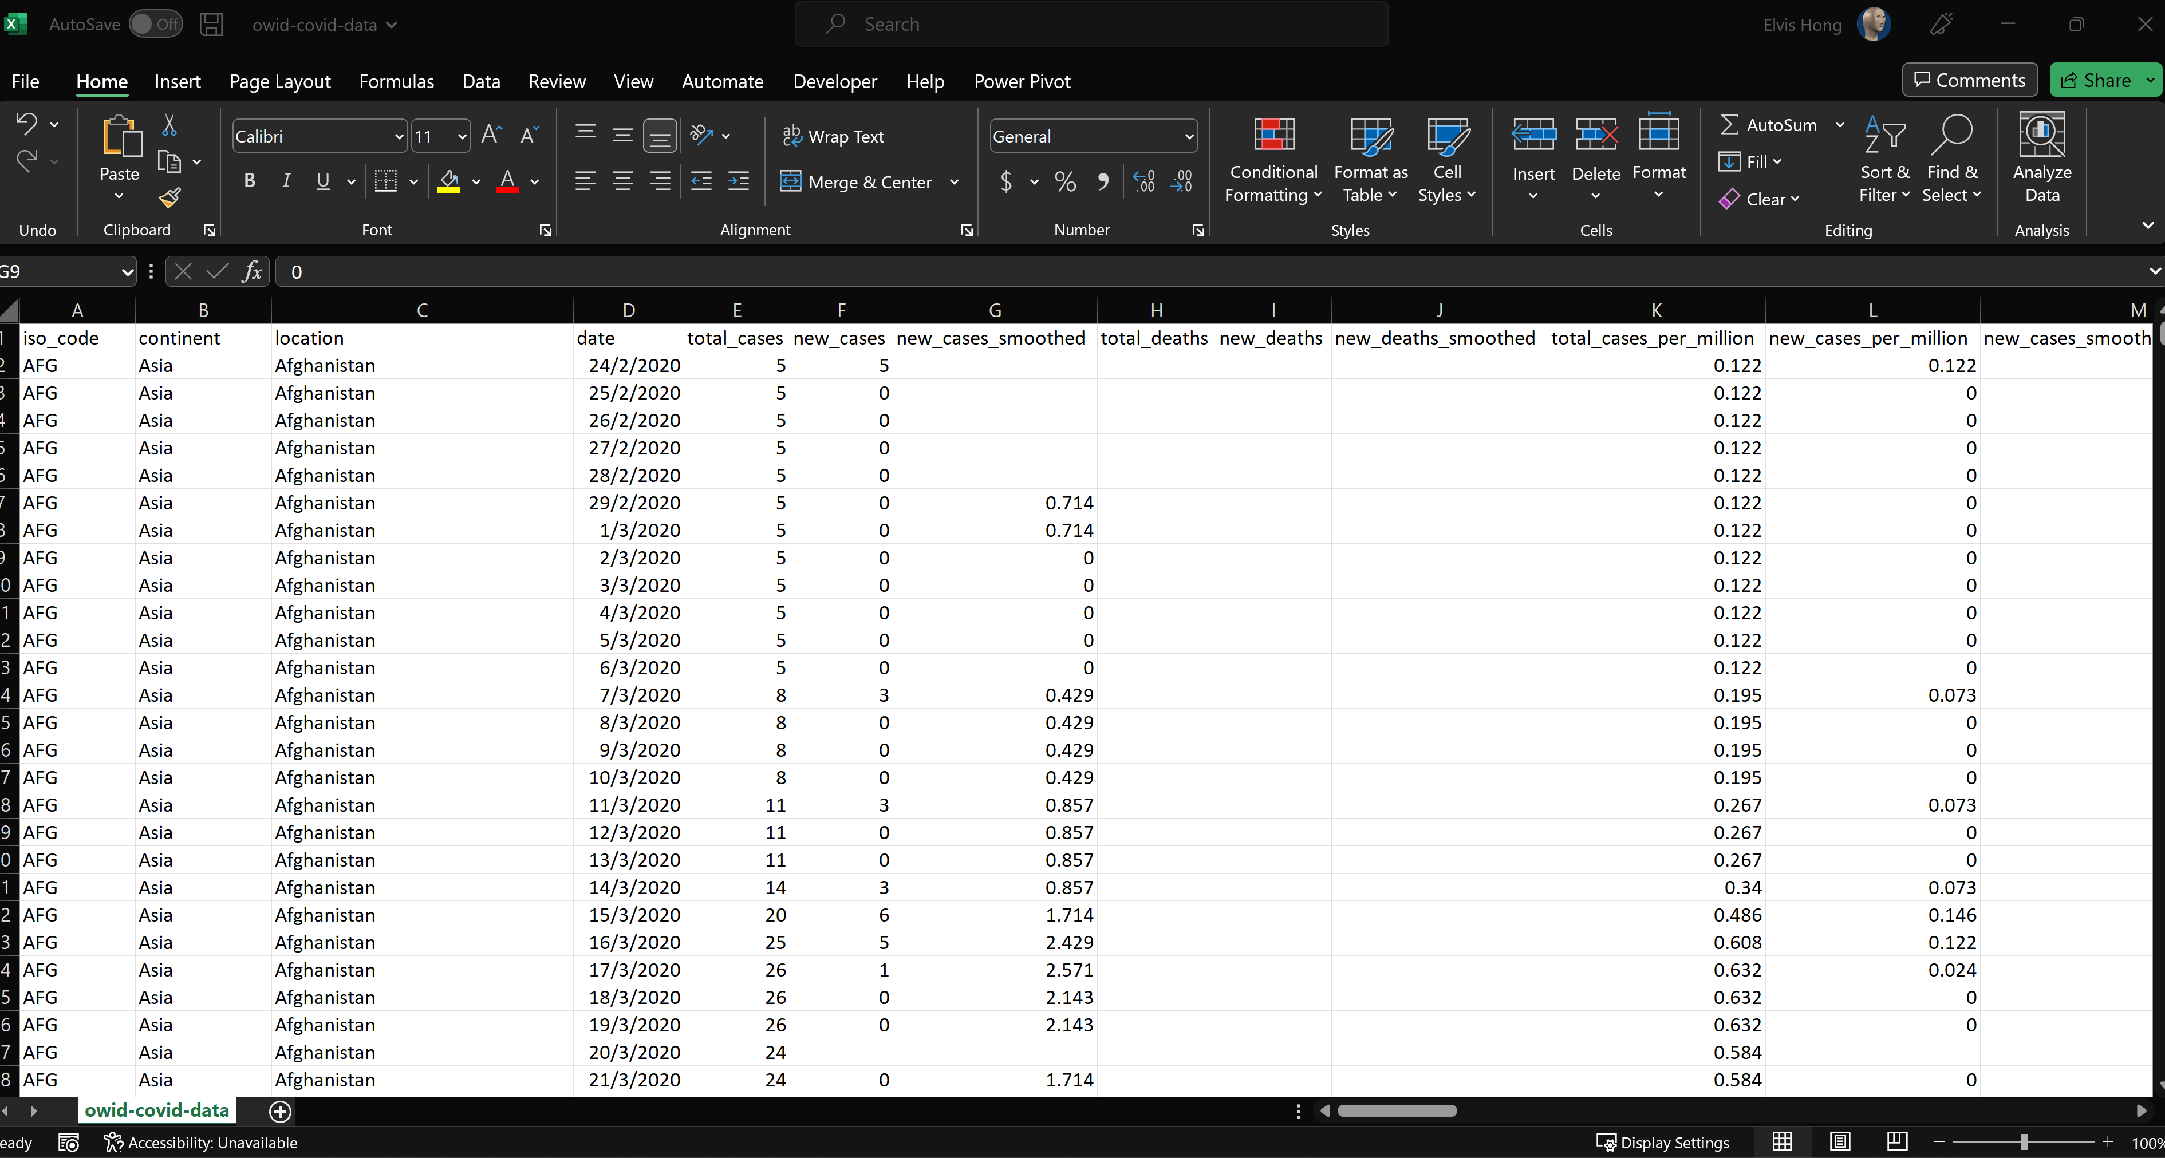
-69.1 MB in size -261 thousand rows of data

Slide 4
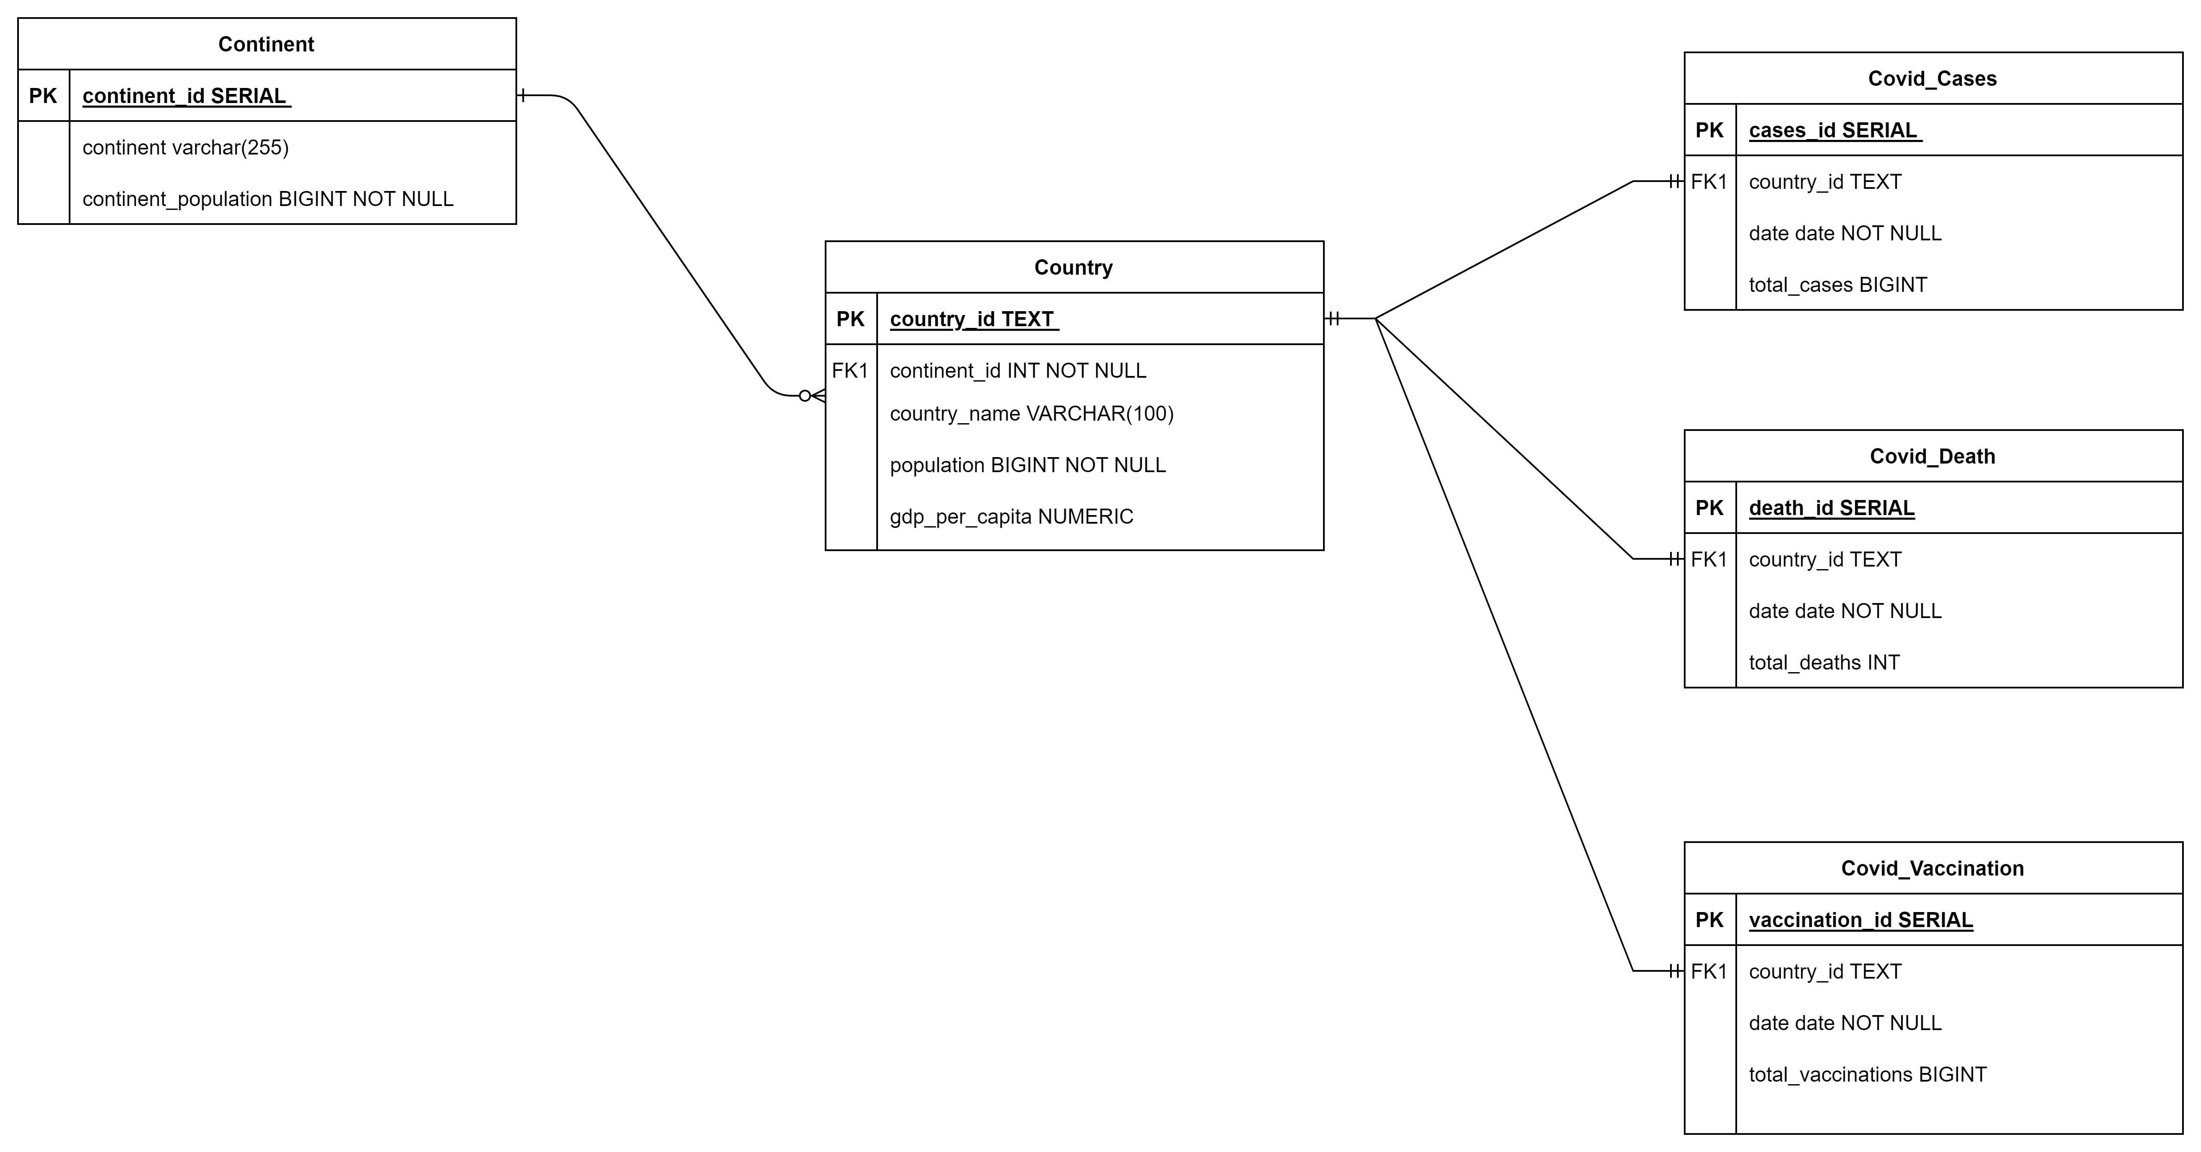
ER Diagram

Slide 5
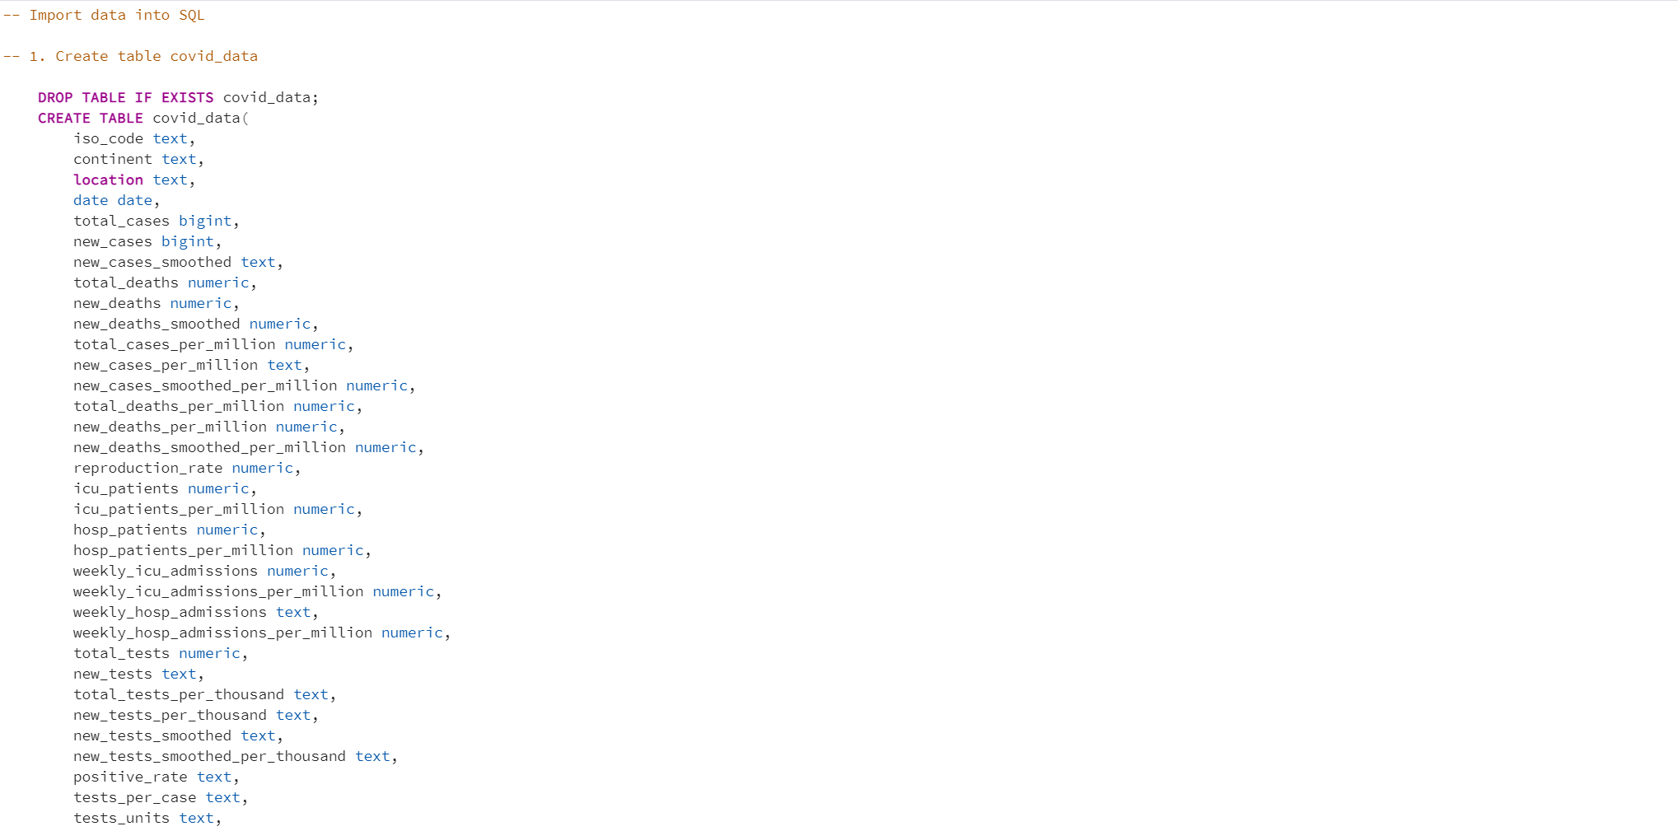

Slide 6
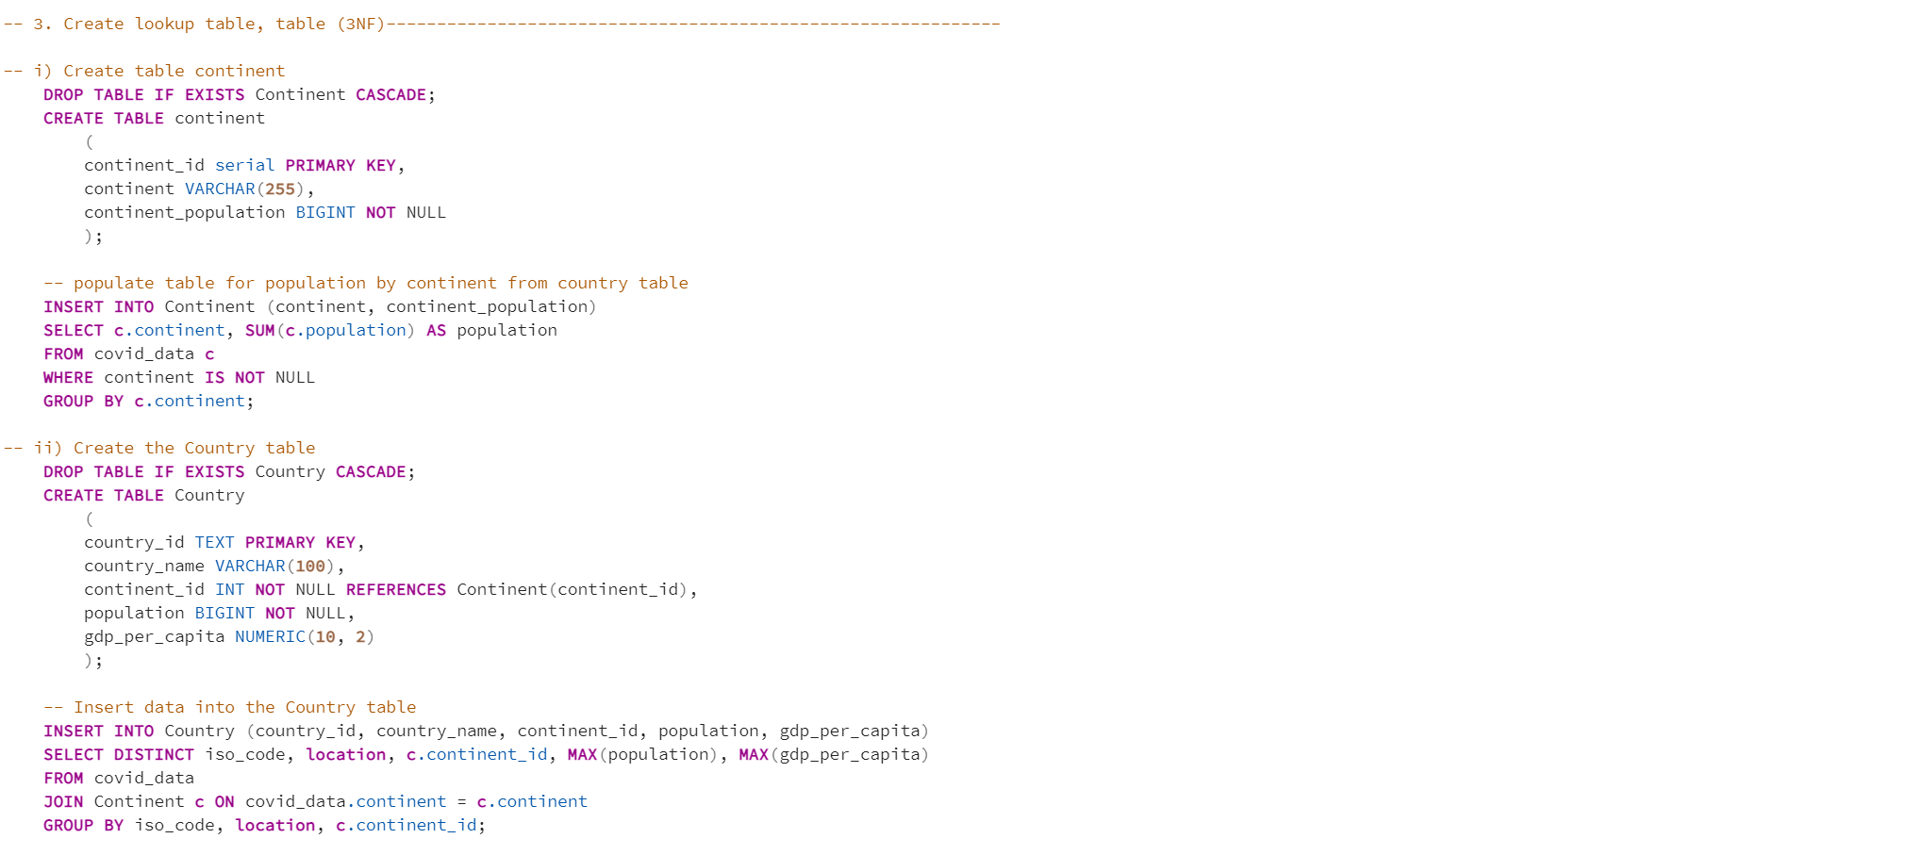
Continent

Slide 7
Country

Slide 8
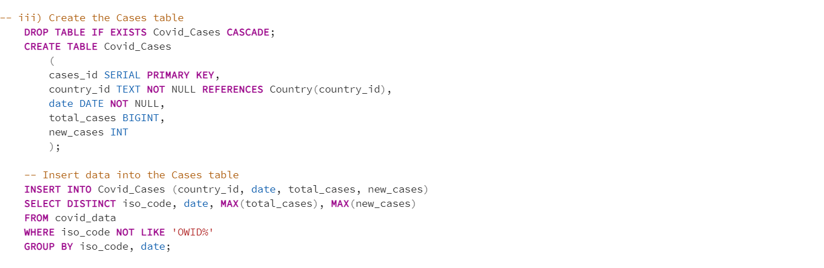
Covid_Cases
03
04
Countries
Effects

Slide 9
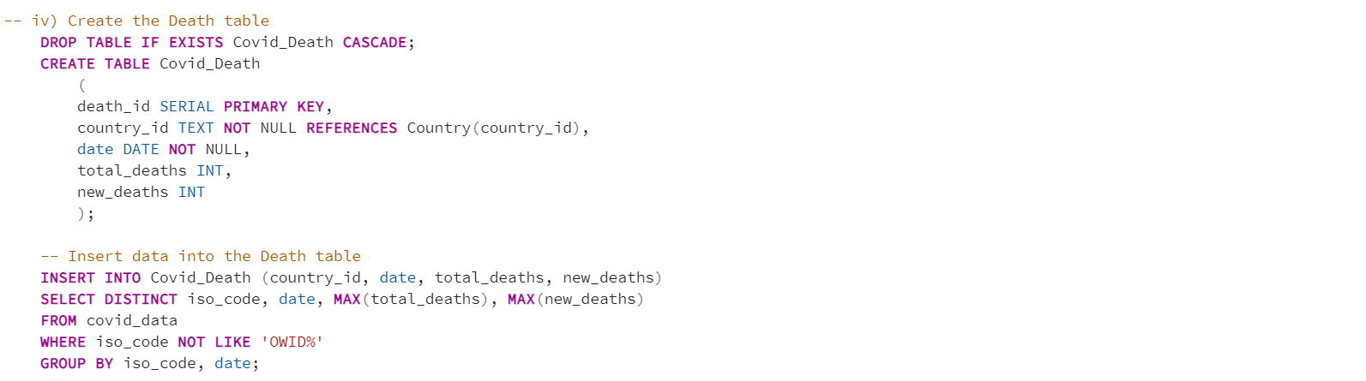
Covid_Death

Slide 10
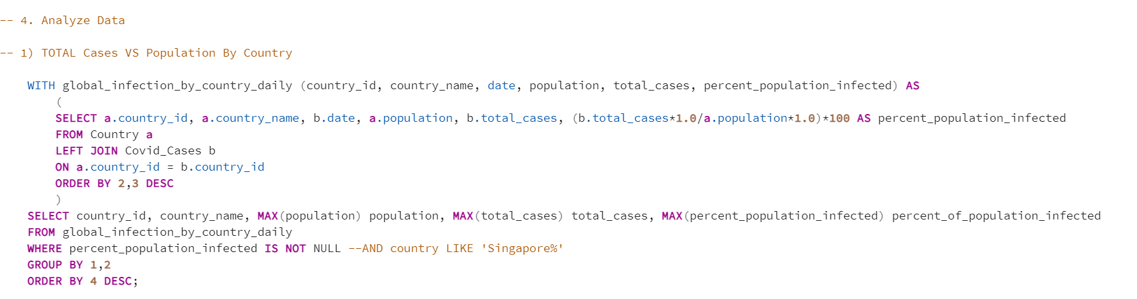
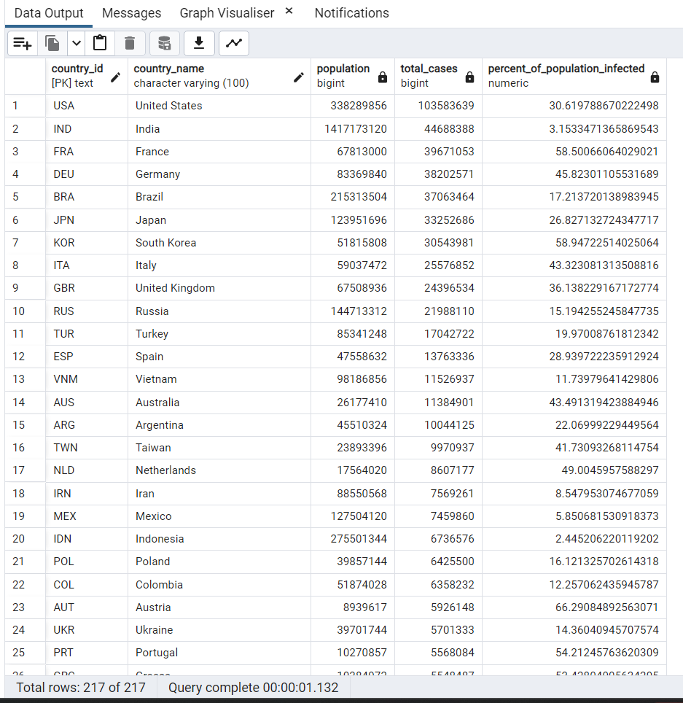
1. Total Cases VS Population By Country

Slide 11
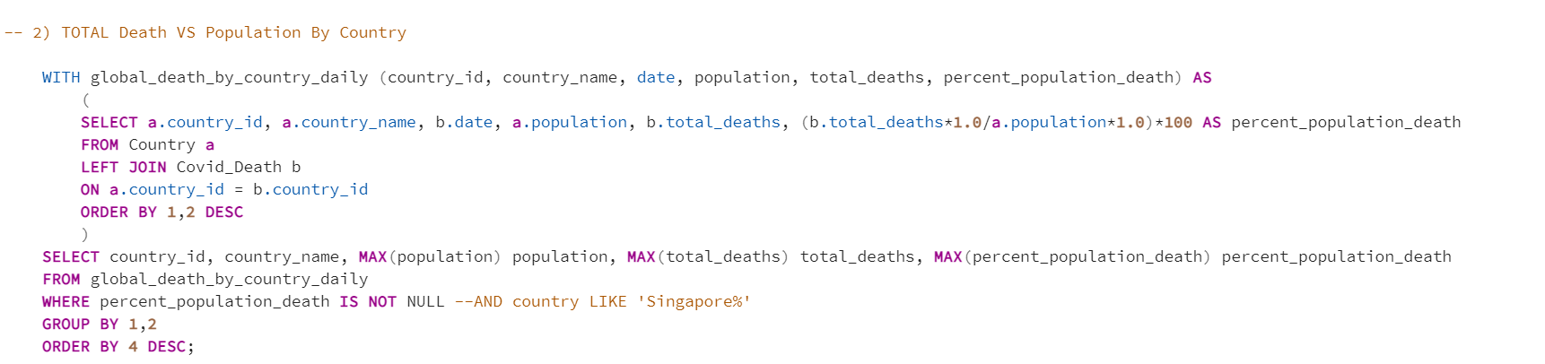
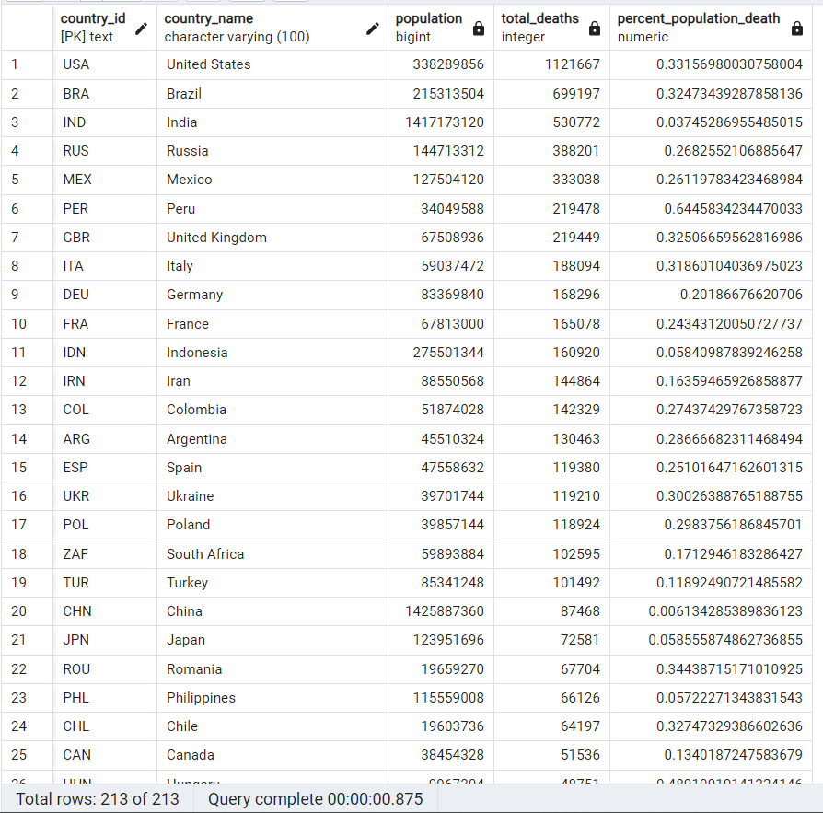
2. Total Death VS Population By Country

Slide 12
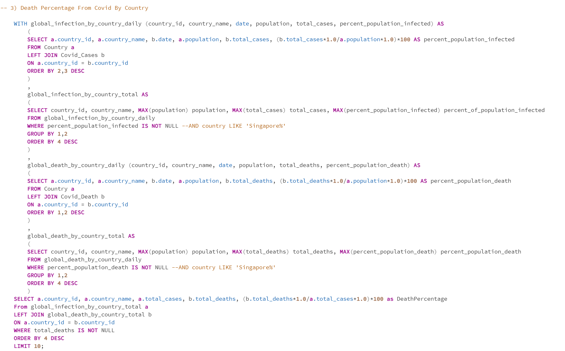
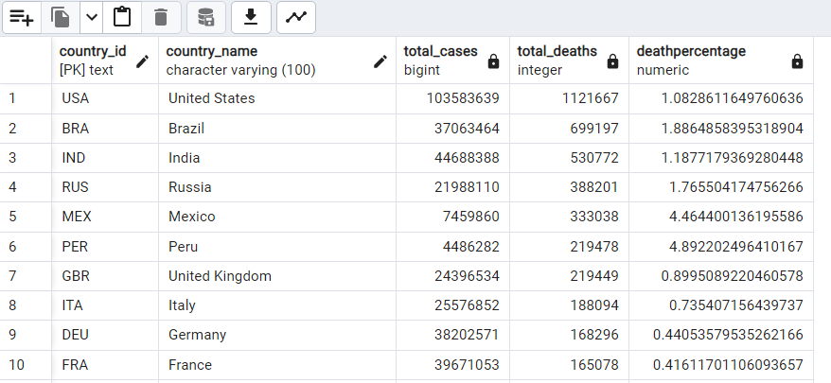
3. Death Percentage From Covid By Country

Slide 13
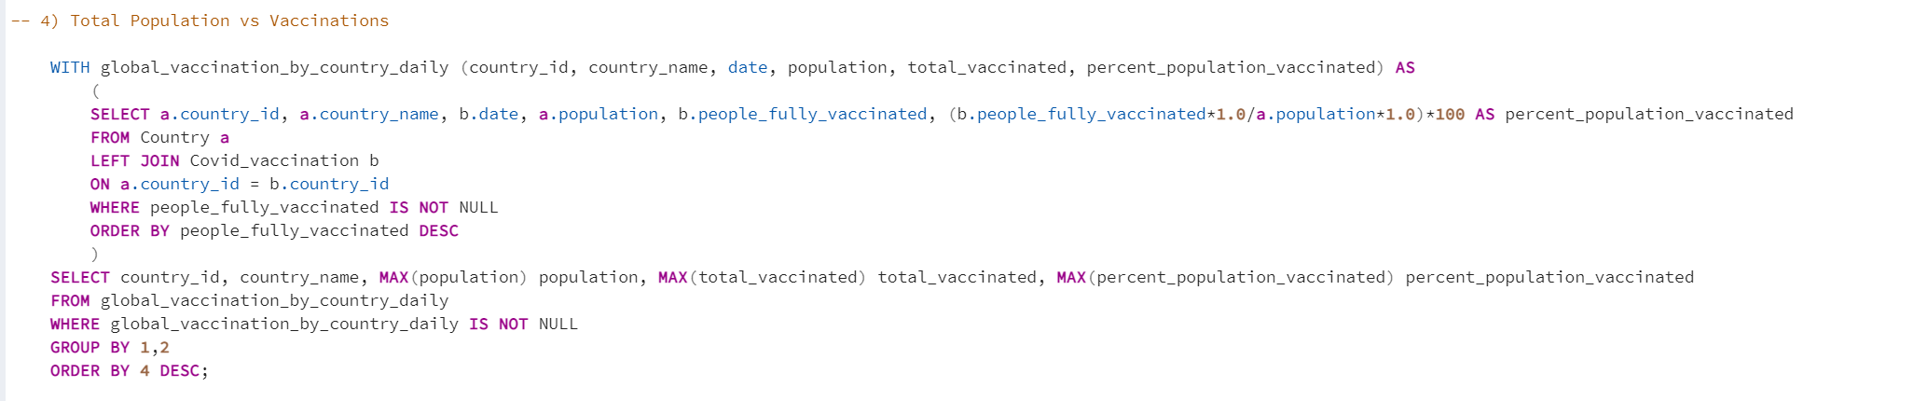
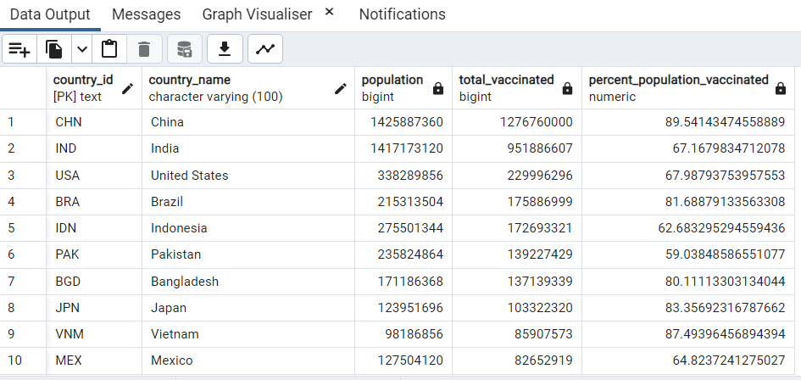
4. Total Vaccinations VS Population By Country

Slide 14
Insight
Country with among the highest mortality are also the having the highest total vaccination

Slide 15
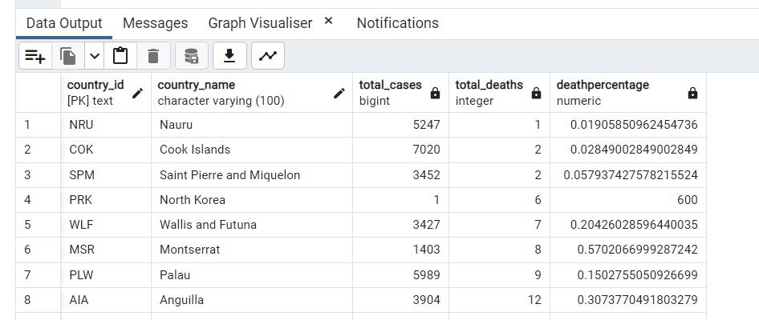
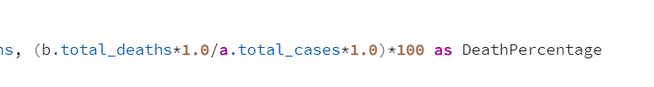
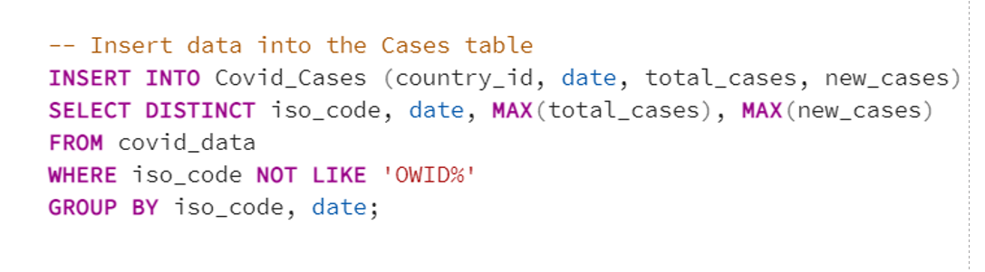
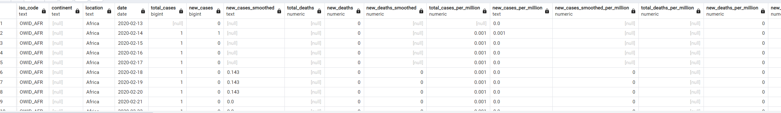
Issue Faced

